Slide 1
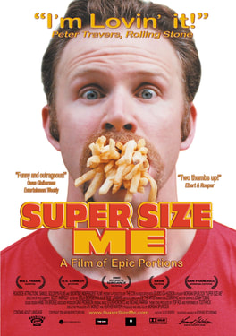
Supersize Me!
Research:
Name of actor
Explain the plot
What does ‘Supersize’ refer to
How did it go?
Problems that the actor faced
Positive review of the film
Criticism(s) of the film
Fair on McDonalds?
What impact did this have on McDonalds?

