Slide 1
Nike: The Sweatshop Debate
By: Group 1 (Pro)
&
Group 2 (Con)

Slide 2
Introduction
Nike, established in 1972 by Philip Knight.
Leading corporation in athletic shoes and sports-equipment.
The numbers…
Yearly revenue of $19.2 billion (2009).
Products in 140 countries.
Contracts to 700 factories in 45 countries.
Employing 800.000 people in the supply chain.

Slide 3
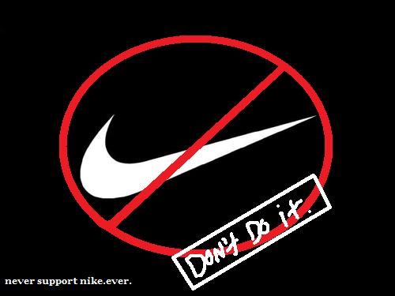
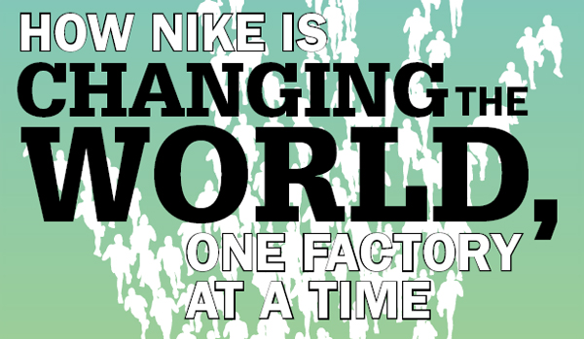
Introduction (Past two decades…)
Anti-globalisation and human rights groups such as Global exchange targeting Nike for,
Sweatshops
Child labour.
Hazardous working conditions
Below subsistence wages.
Measures taken by Nike,
Code of conduct.
Decommissioning.
Auditing tools and task force.

Slide 4
Nike: The Sweatshop Debate
Group 1 (Pro)

Slide 5
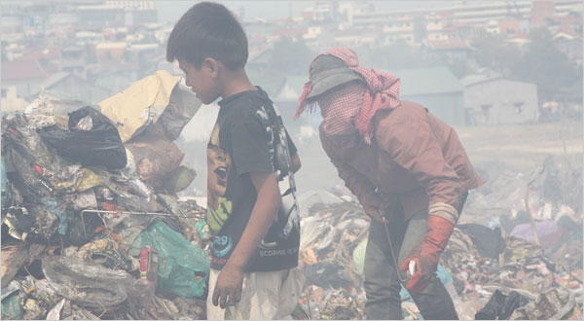
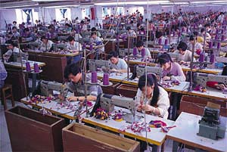
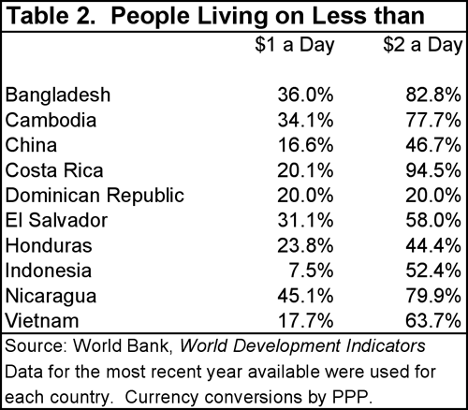
Economic Development : Pro Nike
The only thing worse than being exploited by a capitalist is not being exploited by a capitalist. - Joan Robinson, post-Keynesian economist
Are the Jobs Worth the Sweat?
These factories are an important economic opportunity for the people who work in them.
The average pay at a Nike factory close to Ho Chi Minh (Vietnam) is $54 a month, almost three times the minimum wage for a state-owned enterprise.

Slide 6
Economic Development : Pro Nike
In Vietnam and Indonesia in 2000 and found that workers there earned on average five times each country’s respective minimum wage. (University of Michigan professor Linda Lim)
Per-capita consumption among Vietnam workers in foreign-owned companies is twice the national average.(University of Minnesota professor Paul Glewwe)
The affiliates of U.S. multinational corporations pay on average twice the local wage in the developing world.(Edwin M. Graham of the Institute for International Economics)

Slide 7
Economic Development : Pro Nike
Ten years ago, when Nike was established in Vietnam, the workers had to walk to the factories, often for many km. After three years on Nike wages, they could afford bicycles. Another three years later, they could afford scooters. Today, the first workers can afford to buy a car.
The Nike job comes with a regular wage, with free or subsidised meals, free medical services and training and education. The most persistent demand Nike hears from the workers is for an expansion of the factories so that their relatives can be offered a job as well.

Slide 8
Legal Systems: Pro Nike
Yes Nike is responsible for the conditions of the foreign factories, where they had subcontracted their production.
In 1998 Nike changed the minimum age requirements to 17 yrs ILO (International labor Organization) in all manufacturing countries.
Nike sent letters to universities and college presidents to announce their health, safety and minimum wage requirements.

Slide 9
Employment: Pro Nike
Nike pays Indonesian workers ($2.28), whereas an average worker receives less then $1 a day.
Benefit the least-advantaged members of the global society
Strong market dictates the price.
Workers have a choice to choose where they want to work
Nike have hired independent auditors to make sure that the company subcontractors are living up to Nike’s code of conduct.
Notes:
Must explain

Slide 10
Ethics: Pro Nike
Nike’s immediate efforts to resolve the sweatshop work conditions:
Nike joined a presidential task force in 1996 to find a way of banishing sweatshops, Fair Labor Association
1997: independent organizations like E&Y to audit its subcontractors’ factories
Terminated relations with Indonesian subcontractors who were unwilling to comply with Nike’s standard for wage levels and work conditions

Slide 11
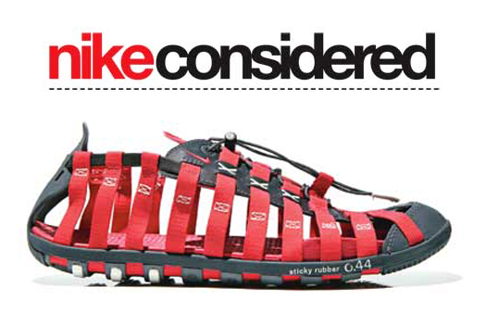
Ethics: Pro Nike
Code of social Responsibility in their supply chain
“…with integrity and a commitment to the highest ethical standards” – Nike, Code of Ethics

Slide 12
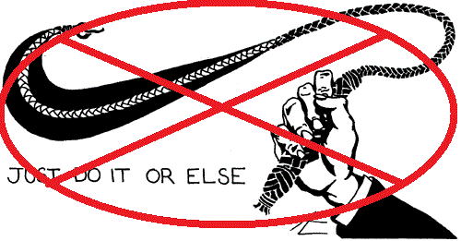
Public Perception: Pro Nike
“There aren’t too many sweatshops, but that there are too few”
Better than starvation & destitution.
The conditions in the contract factory nowadays.
Public perspective
Sweatshop are not all bad, they can be considered as a better option for the world than a bad one.

Slide 13
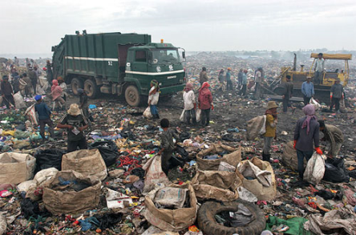
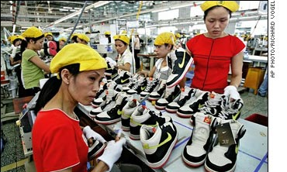
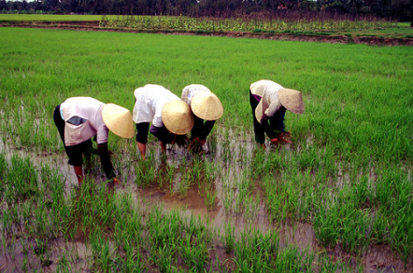
Conclusion: Pro
“Exploiting people? Nobody in my country thinks about companies exploiting them. When there is a new company opening a factory, people are excited about it”
June Arunga, journalist from Kenya
X

Slide 14
Nike: The Sweatshop Debate
Group 2 (Con)

Slide 15
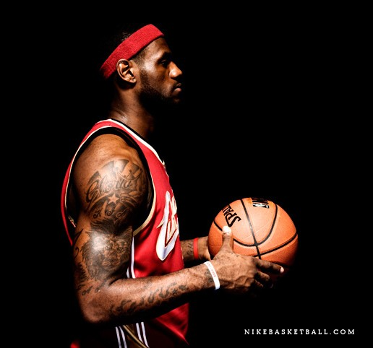
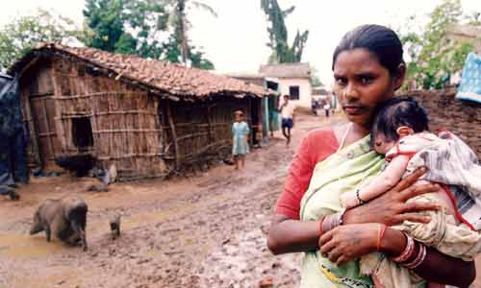
Economic Development: Con Nike
Dichotomy of Global Development
$12.8 Million Dollars/ Year
vs.
$480 Dollars/ Year

Slide 16
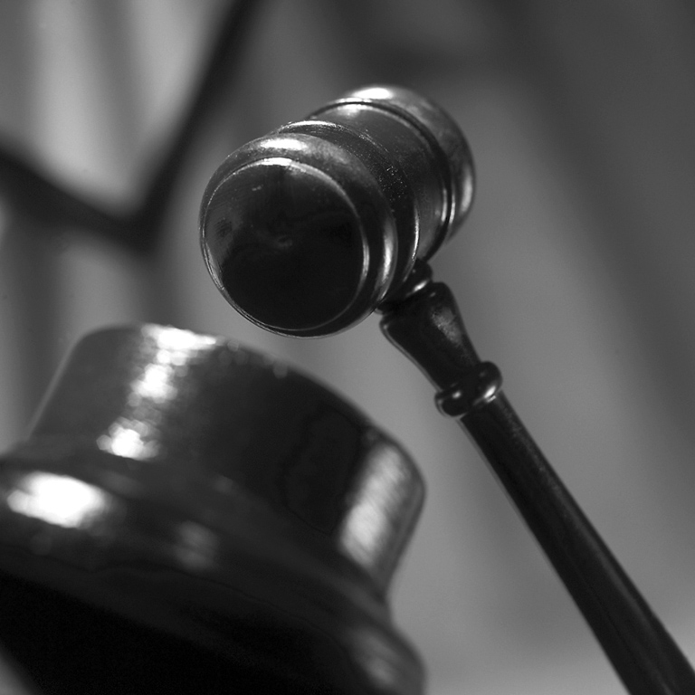
Legal Systems: Con Nike
Labor Law
Collective Labour Law
Individual Labour Law
- Contract of Employment

Slide 17
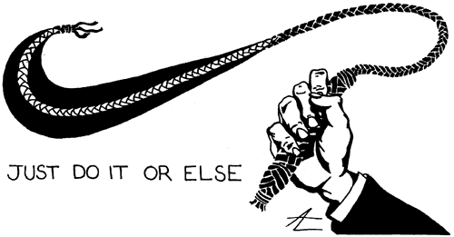
Employment Law: Con Nike
Employment Practices
Human Rights
Universal Declaration of Human Rights
Ethical Dilemmas – Exploitation or job provider?

Slide 18
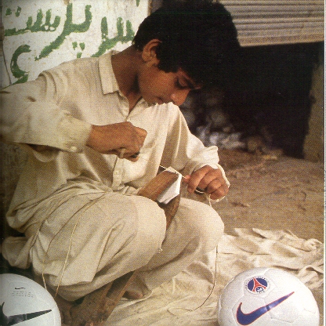
Ethics: Con Nike
Nike- A Good Chess Player
Philippines
Korea
Indonesia
Vietnam
“A Symbol of the Evils of Globalization”

Slide 19
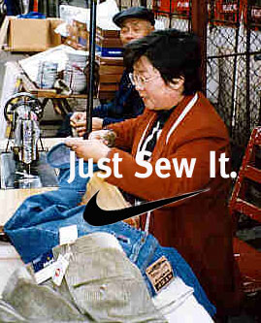
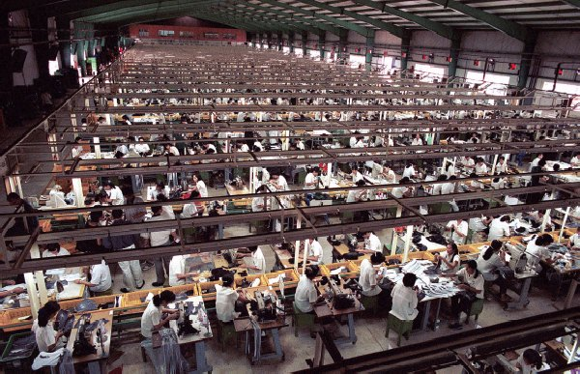
Public Perception: Con Nike
USAS- United Students Against Sweat Shops
WRC- Worker’s Rights Consortium
“Nike’s Wealth was built upon the backs of the worlds poor”

Slide 20
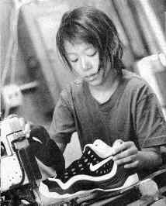
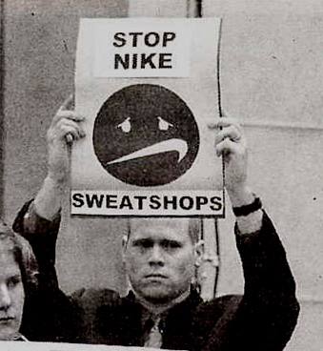
Conclusion: Con
As of 2009 Nike walked away with $1.4 Billion in per annum net income.
The question is “why”?
“Greatness is earned, never awarded.” - Nike

Slide 21
References
HILL. W. L. C., International Business, competing in the global marketplace, McGraw-Hill companies, New York, 8th edition, chapter I-VI.
http://www.nikebiz.com/responsibility/
http://www.foxnews.com/story/0,2933,119125,00.html
http://www.saalonmuyo.com/2009/01/16/man-in-suit-says-sweatshops-are-good/
http://blog.riseofreason.com/why-“sweatshops”-are-good-for-everybody/10/
http://www.econlib.org/library/Columns/y2008/Powellsweatshops.html
http://english.vietnamnet.vn/reports/2005/11/510780/
http://www.nikebiz.com/responsibility/workers_and_factories.html
http://invest.nike.com/phoenix.zhtml?c=100529&p=irol-govConduct

Slide 22
Bibliography
Journal of Business Ethics; Aug2008, Vol. 81 Issue 1, p143-156, 14p, 3 Diagrams, 2 Charts
Journal of Business Ethics; Apr/May2008, Vol. 79 Issue 1/2, p179-198, 20p, 5 Charts, 2 Graphs
International Business by Charles W. L. Hill, ISBN: 0073381349, published by McGraw Hill/Irwin (7th edition).

