Slide 1
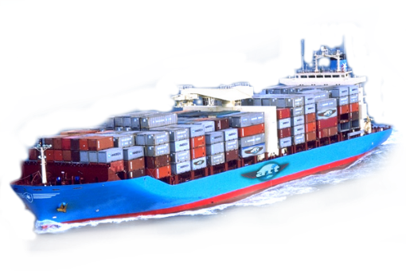
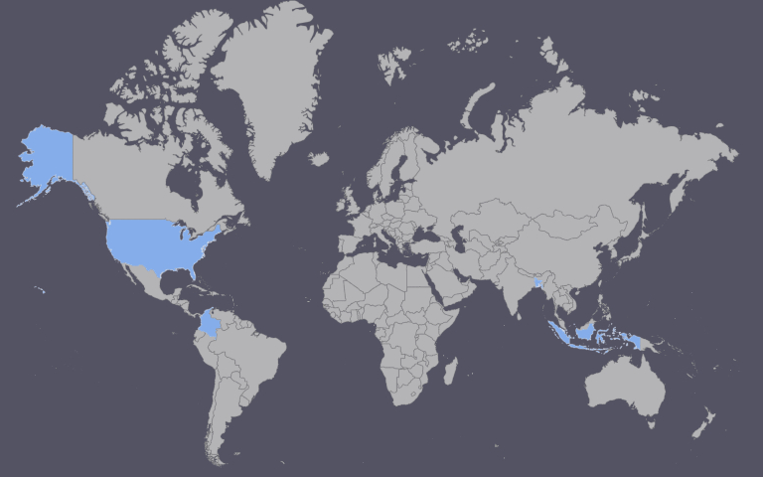
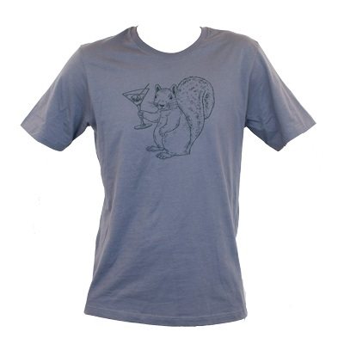
Stage 1 – The Cotton Farm
How many t-shirts?
The completed t-shirts are then loaded back onto the shipping container in Columbia and Captain Ernesto Alas sails the shipping container back to Florida where the container is loaded onto a train and begins its journey to the distribution centre where it will be unpackaged and then sold in a store. This completes the journey of several thousand KM at a cost of $0.07 per t-shirt in transport!
Photo of person involved, name and job title
Photo of person involved, name and job title
Journey of a
Stage 3b Womens t-shirt Columbia
Stage 2 – The Machines
Photo of factory involved
Stage 3a – Mens T-shirt Bangladesh
Photo of person involved, name and job title

