Slide 1
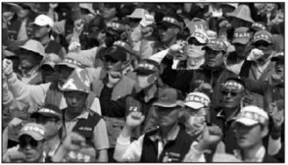
Why is this happening?
Who are the people?
What is happening here?

Slide 2
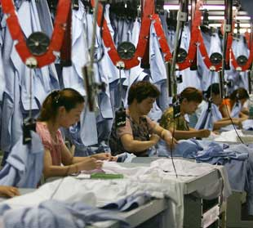
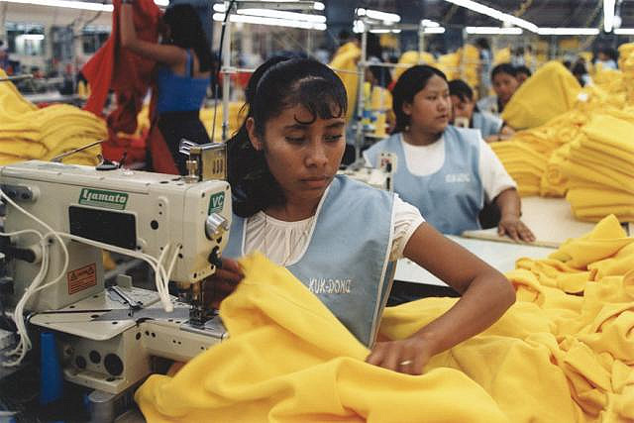
Improving Sweatshops
Learning Objective:
To understand ways in which the world’s sweatshops can be improved.

Slide 3
Learning Outcomes:
By the end of the lesson:
All will have been able to identify ways to improve Sweatshops (grade C).
Most will have been able to justify ways in which to improve a sweatshop (grade B).
Some will have been able to analyse development plans and offer improvements (grade A/A*).

Slide 4
Think back to last lesson…
What are the problems with sweatshops?

Slide 5
Improving Sweatshops.
Task 1: Improving Sweatshops.
You are a Bangladeshi factory owner.
The garments your factory makes are bought by Primark.
You are to develop a 2 year improvement plan and a longer term plan.
You have $100,000 to spend on developments each year.
You need to justify and give reasons why you have chose certain ways to develop your factory.

Slide 6
Learning Outcomes:
By the end of the lesson:
All will have been able to identify ways to improve Sweatshops (grade C).
Most will have been able to justify ways in which to improve a sweatshop (grade B).
Some will have been able to analyse development plans and offer improvements (grade A/A*).

Slide 7
Improving Sweatshops.
Task 2: Peer assessment
When peer assessing you need to consider:
How well has the brief from Primark been met?
What are the best points of the plan? And say why?
What are the areas you feel they need to develop the plan further and why?
Score it out of 10 on how well you think it met Primark’s brief.

Slide 8
Plenary: Improving Sweatshops
Write a tweet to Primark outlining the most important improvement that they need to implement in the factories that produce their garments.
@primark

