Slide 1
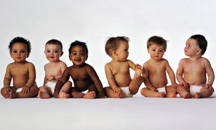
France – 2.1 Baby Boom!
How does the fertility rate of France compare with the average EU rate?
Outline how the French attitude to family values differ from that in eastern Asia
Which EU countries follow the Asian approach?
What is the link between fertility rate and women in work? Outline % figures in your response.
How does the Rabenmutter approach hinder fertility rates in Germany?
What is the link between welfare policies and fertility?
Outline the liberal approach of the French government to childcare .
How does day care for toddlers link with fertility and women in work?

