Slide 1
France: A pro-natalist population policy
Notes:
Image from www.frenchflag.us

Slide 2
What is a pro-natalist policy?
A pro-natalist policy is a population policy which aims to encourage more births through the use of incentives.

Slide 3
Why population policies?
In most developed countries, the decline in fertility and the increase in longevity has raised three concerns for the future:
the decrease in the supply of labour,
the socioeconomic implications of population ageing, and
the long term prospect of population decline and demise.

Slide 4
The French policy
Long history - in 1939 the French passed the ‘Code de la famille’ – a complex piece of pro-natalist legislation.
Offered cash incentives to mothers who stayed at home to care for children.
Subsidised holidays
Banning of the sale of contraceptives (repealed in 1967)

Slide 5
French government incentives:
Payment of up to UK €1400 to couples having third child
Generous maternity grants
Family allowances to increase the purchasing power of three-child families
Maternity leave, on near full pay, ranges from 20 weeks for the first child to 40 or more for a third.
100% mortgage and preferential treatment in the allocation of 3 bedroomed council flats

Slide 6
More government incentives….
Full tax benefits to parents until the youngest child reaches 18
30% fare reduction on all public transport for 3 child families
Pension schemes for mothers / housewives
Child-orientated development policies e.g. provision of creches, day-nurseries etc
Depending on the family's income, childcare costs from virtually nothing to around €500 a month for the most well-off.
Nursing mothers are encouraged to work part-time or take a weekly day off work

Slide 7
“France plans to pay cash for more babies” Headline in the British Guardian 2005
French celebrate biggest baby boom since 1980s Independent January 2007
“France had more babies in 2006 than in any year in the past quarter century, capping a decade of rising fertility that has bucked Europe's greying trend.“
“As its population ages, France needs more babies” San Diego Union-Tribune Feb 06
“Cash payments, tax breaks and subsidized child care have helped make France's fertility rate the second highest in Europe. It still isn't high enough to rescue the country from an aging population that threatens state spending on pensions and health.”

Slide 8
Social protection benefits for the families in Europe: cash / in kind [education excluded] (in % of GDP)

Slide 9
Some traits of the French family policy
Complex and not always consistent
More than 30 measures (not easy to evaluate)
Means-tested benefits (for social redistribution), but also tax cuts (quotient familial, tax-splitting system")
Still wavering between extra support to the 3rd child and benefits from the 1st child
But quite consensual and politically neutral
Unquestioned in the last electoral debates
Confirmed every year by la Conférence de la famille
More feministic then familistic
No need to be married; no need to stay home
Strong support to the one-parent families
A 60-year continuity that inspires confidence in the population
Notes:
www.munich-economic-summit.com/mes_2007/speeches/sp_heran.ppt

Slide 10
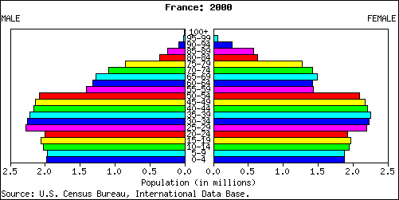
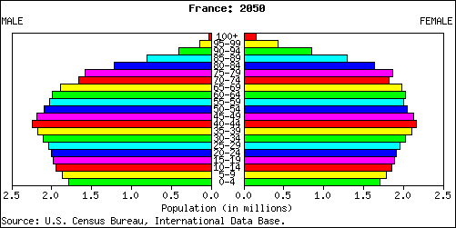
Some increase in birth rate (now moving into older age groups)

Slide 11
A temporary additional fertility (baby-boom) which first rejuvenates the population…
Notes:
www.munich-economic-summit.com/mes_2007/speeches/sp_heran.ppt

Slide 12
…but 40 years later makes it older

Slide 13
Ageing population
Total fertility rates in France declined from the 1960s to the 1990s
1960 fertility rate 2.73 (children per woman)
1992 fertility rate 1.73
But…..2007 1.98 children born/woman
ALSO….
Ageing population (and associated problems)
Notes:
https://www.cia.gov/library/publications/the-world-factbook/geos/fr.html

Slide 14
Population aged 65+ and population aged 15-64 FRANCE 2000-2050 (per 100 persons in 2000)

Slide 15
Are immigrants the reason for the growth in population?
It is often claimed that the French fertility rate is due to foreign population
Surprising though it may seem, the foreign population brings a large contribution to births but a limited impact on fertility
2005: 94 000 babies born to a foreign mother out of 774 000 = 12 %
This raises the national fertility rate by just 0.10 child, from 1.8 (for French women) to 1.9 (for women of all nationalities)
Explanation:
Foreign women have 1.5 child more than the nationals
But represent only 7% of the female population of childbearing age
➔ the 1.5 additional child accounts only for 7% in the national rate
The impact of foreigners on the number of births depends more from the extra number of foreign women than from their extra fertility
If we take immigrant rather than foreign women, the contribution to births increases, while the contribution to fertility gets smaller
since the immigrants have arrived at an earlier age, they resemble more native French women in terms of fertility
Notes:
www.munich-economic-summit.com/mes_2007/speeches/sp_heran.ppt

