Slide 1
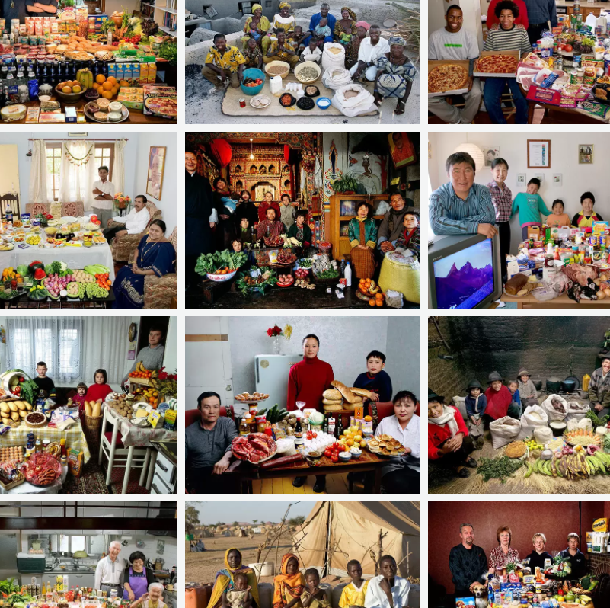
Food Around The World
Fact Finding Mission
Name:

Slide 2
The Revis family from Raleigh in North Carolina. Their weekly shopping costs €250

Slide 3
The Dudo family in Sarajevo, Bosnia. Their weekly shopping costs €115

Slide 4
The Aymo family of Tingo, Ecuador, with a week's food that costs €23

Slide 5
The Aboubakar family from Darfur, Sudan, in the Breidjing refugee camp in Chad. Their weekly food, which feeds six people, costs 0.85c

Slide 6
The Melander family from Bargteheide, Germany, who spend around €380 on a week's worth of food

Slide 7
The Madsen family from Kap Hope village in Greenland with their weekly groceries that cost €190

Slide 8
The Matsuda family from Yomitan, Japan, who spend €155 a week on groceries

Slide 9
The Patkar family from Madhya Pradesh in India with a week's worth of food, costing €30

Slide 10
The Bainton family from Wiltshire in the UK, who spend around €180 on their weekly food

Slide 11
The Namgay family from Shingkhey, Bhutan, with a week's worth of food that costs them around €4

Slide 12
The Batsuuri family in Ulan Bator, Mongolia, with a week's food that costs €35

Slide 13
The Natomo family from Kouakourou, Mali, who spend €20 a week on food

