Slide 1
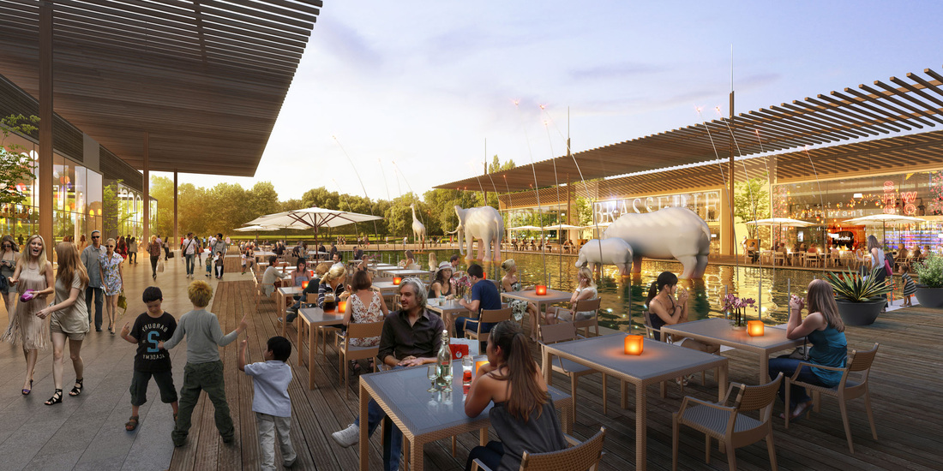
What & Where Is This Place?

