Slide 1
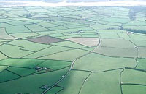
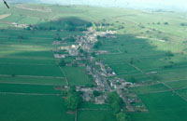
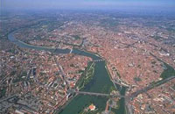
Settlement Patterns
Dispersed
Linear
Nucleated

Slide 2
Settlement Patterns and Hierarchy
Using your OS map find as many examples of settlement patterns as you can and fill in the table below.
Village Name
Grid Reference
Settlement Pattern
Reason

Slide 3
Settlement Patterns and Hierarchy
Today we are learning about…
the different shapes villages come in called patterns, these patterns are dictated by physical geography.
The size of settlements is also linked to the amount of services it has; this is called settlement hierarchy.
By the end of the lesson…
ALL can identify settlement patterns and sort settlements by size (Level 3)
MOST will be able to describe settlement patterns and settlement characteristics by size (Level 4)
SOME will be able to explain why a settlement has a certain pattern and explain the link between size and the number of services it has (Level 5)

Slide 4
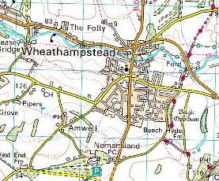
Nucleated, Linear or Dispersed?
Why?

Slide 5
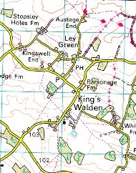
Nucleated, Linear or Dispersed?
Why?

Slide 6
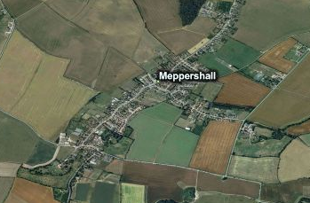
Nucleated, Linear or Dispearsed?
Why?

Slide 7
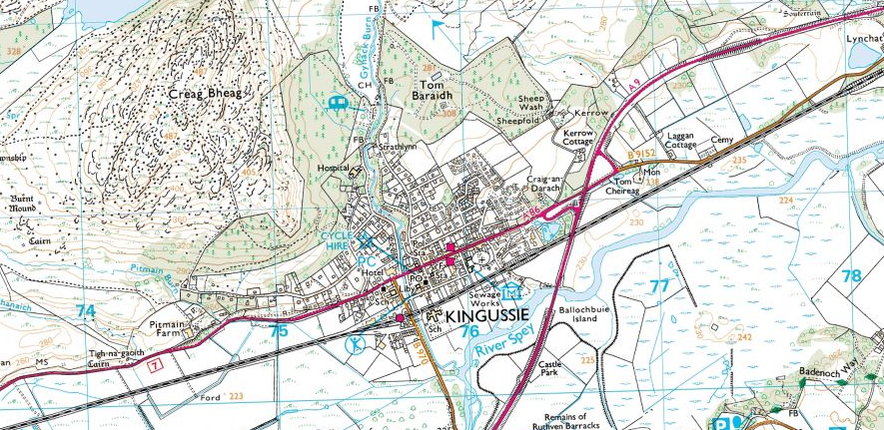
Nucleated, Linear or Dispersed?
Why?

Slide 8
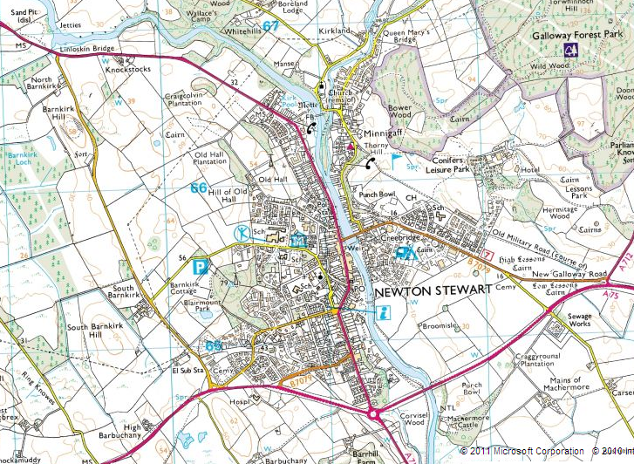
Nucleated, Linear or Dispersed?
Why?

Slide 9
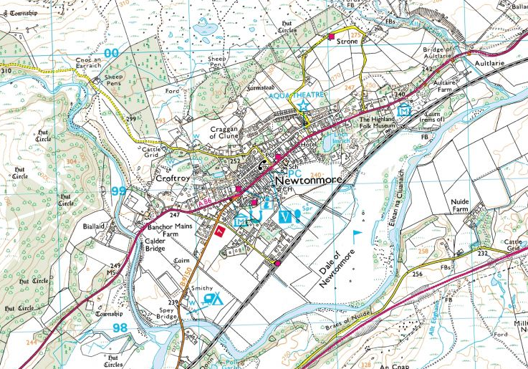
Nucleated, Linear or Dispersed?
Why?

Slide 10
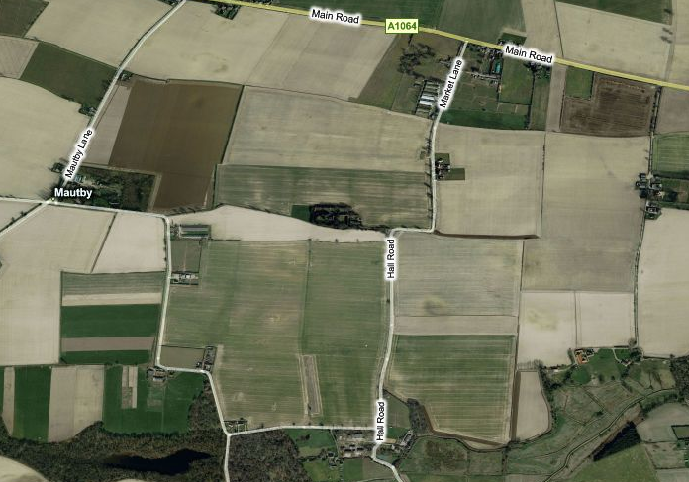
Nucleated, Linear or Dispersed?
Why?

