Slide 1
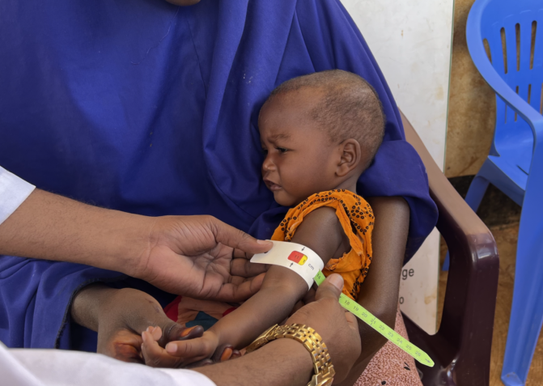
7 World hunger facts
A presentation by
Key source of information - here

Slide 2
Key Resource https://www.visualcapitalist.com/interactive-map-tracking-global-hunger-and-food-insecurity/

Slide 3
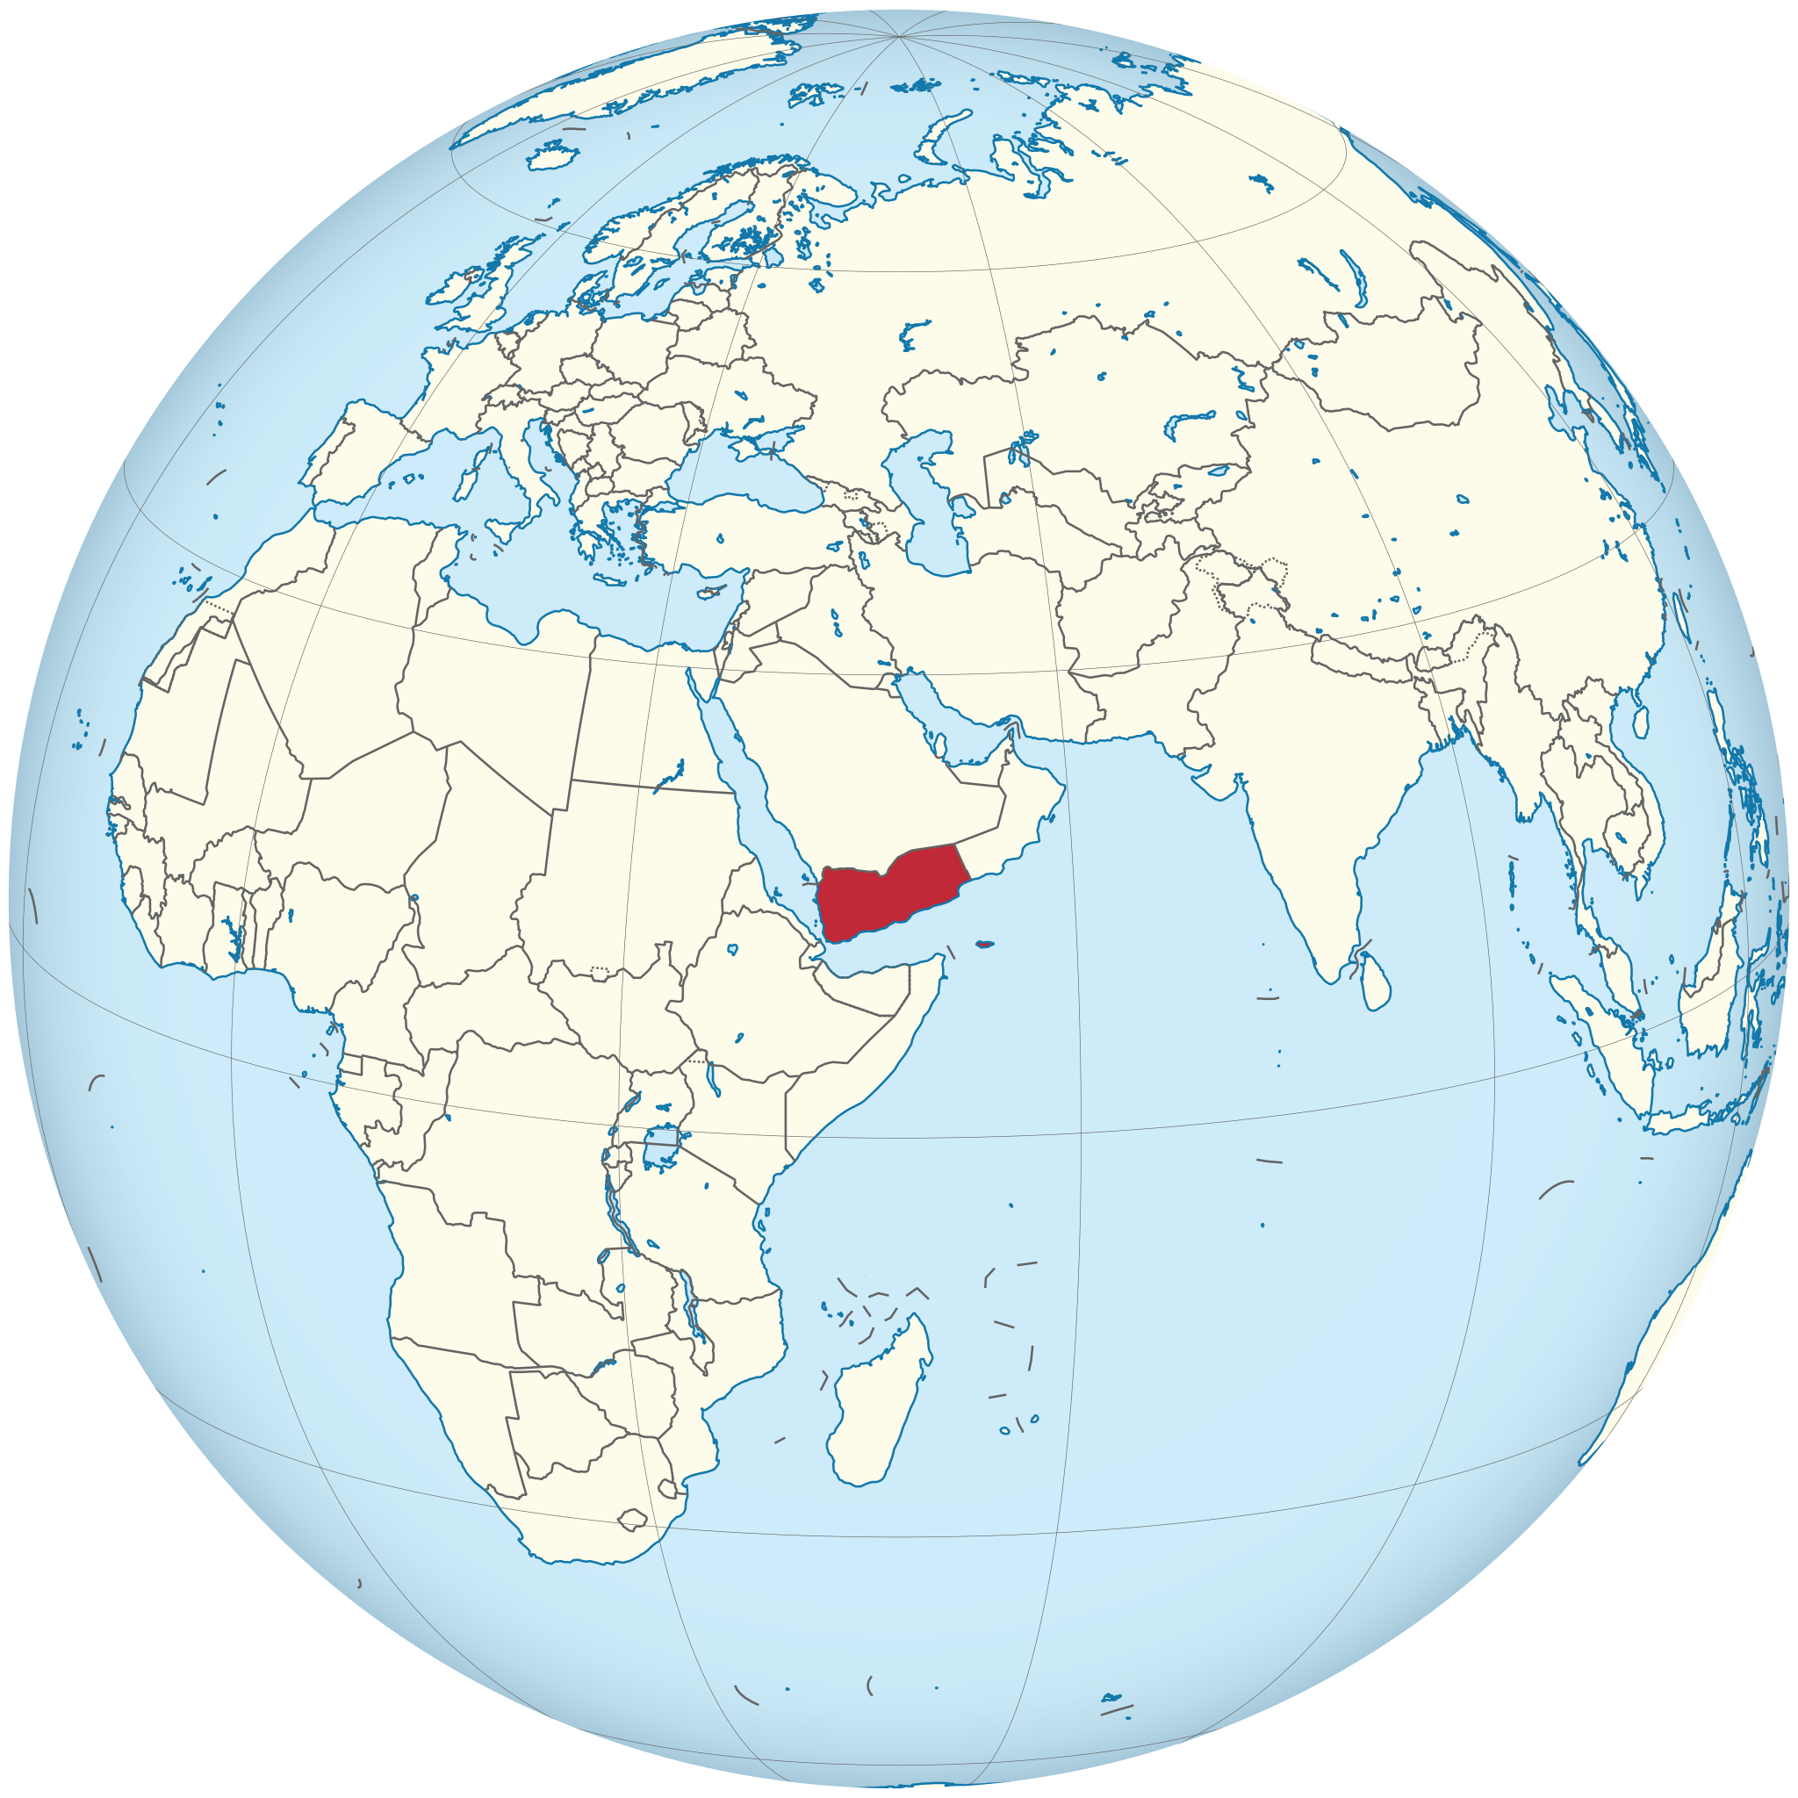
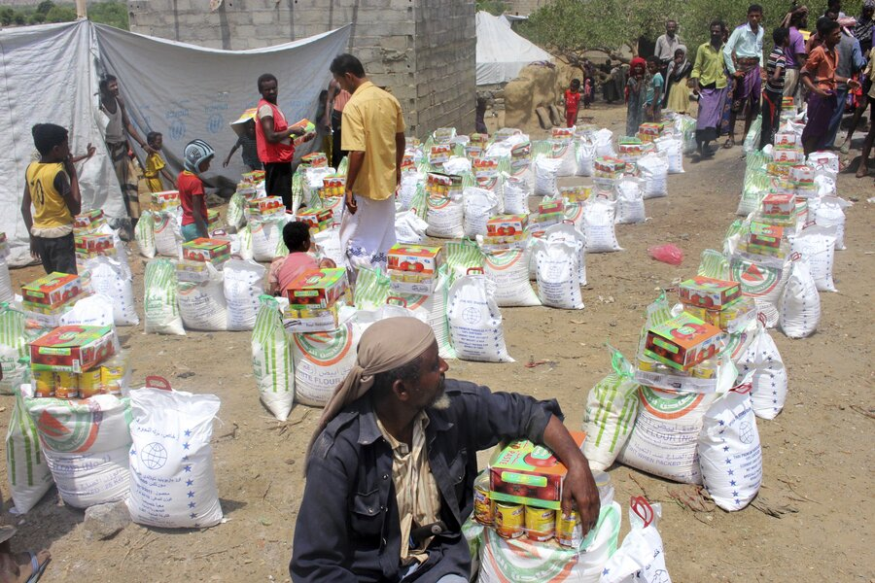
1. Food insecurity is growing: Focus: Yemen
In 2022, there were 258 million people in 58 different coutries around the world who did not have adequate access to food supplies. Their lives were in danger and worryingly, this is the highest number of hungry people EVER recorded!
Yemen Total Population | Yemen People with insufficiant food consumption
30 million | 15 million (50%)

Slide 4
2. Conflict, economic shocks, and weather extremes impact world hunger – Mali
Summary from website
Mali Total Population | Mali People with insufficiant food consumption

Slide 5
3. The war in Ukraine is impacting global hunger:
Summary from website
Ukraine Total Population | Ukraine People with insufficiant food consumption

Slide 6
4. Food insecurity forces families into distressing choices:
Summary from website
Click this link and comment on the global pattern of child marriage. How much does it link to the interactive hunger map?

Slide 7
5. Millions of children are dangerously malnourished
Summary from website
Click this link and comment on the global pattern of child malnutrition. How much does it link to the interactive hunger map?

Slide 8
6. Displacement is both a driver and a consequence of food insecurity:
Summary from website
Click this link and comment on the global pattern of displacement as a result of conflict. How much does it link to the interactive hunger map?

Slide 9
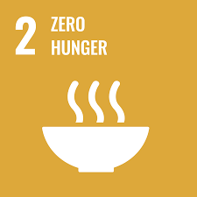
7. Humanitarian organizations around the world are working toward the goal of ending hunger:
Summary from article

