Slide 1
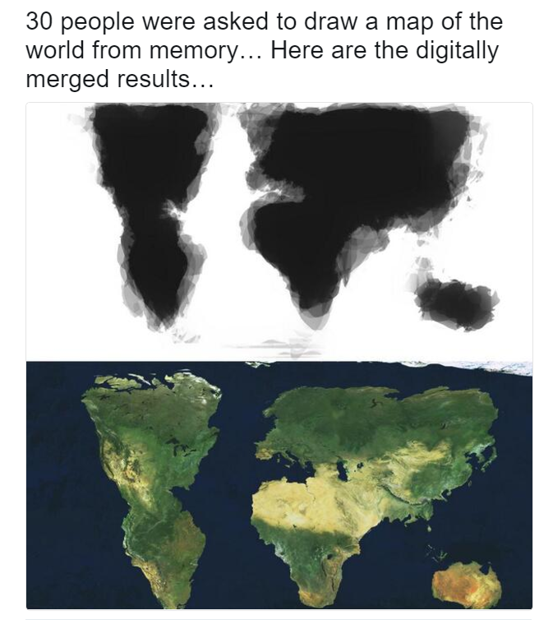
TOKOGRAPHY Lesson 2

Slide 2
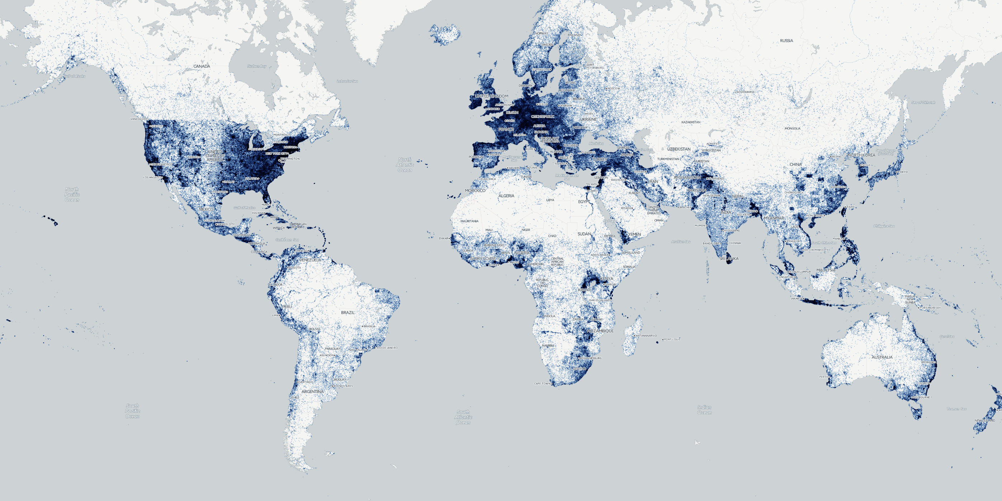
Where our news came from in 2015
The map above shows the overall geography of 2015’s news stories, placing a dot at each location on earth mentioned in at least one story of the year. Keep in mind that these are not just byline locations, these reflect every single mention of a location across the entire body of each of those 200 million articles.

Slide 3
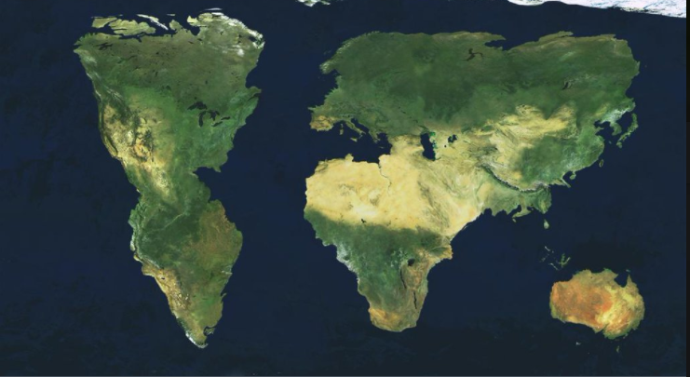

Slide 5
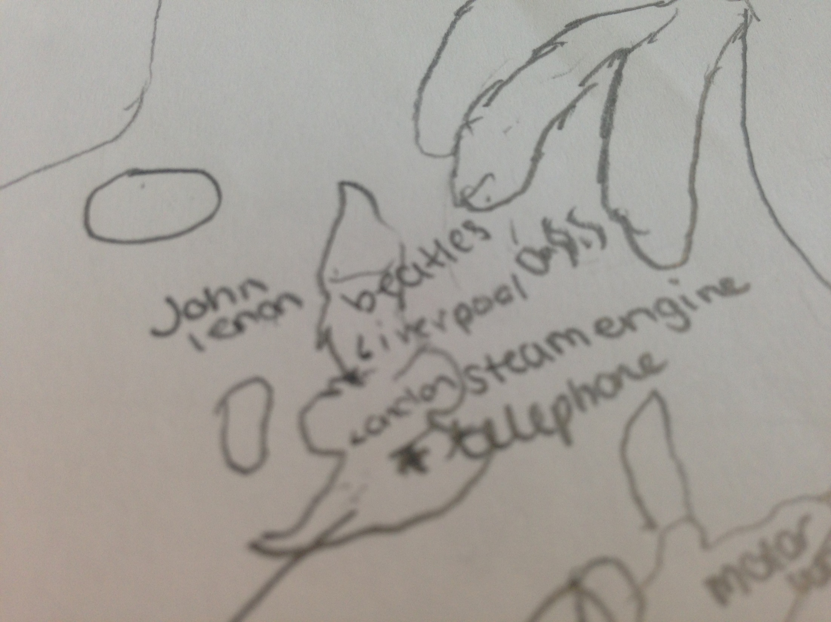

Slide 6
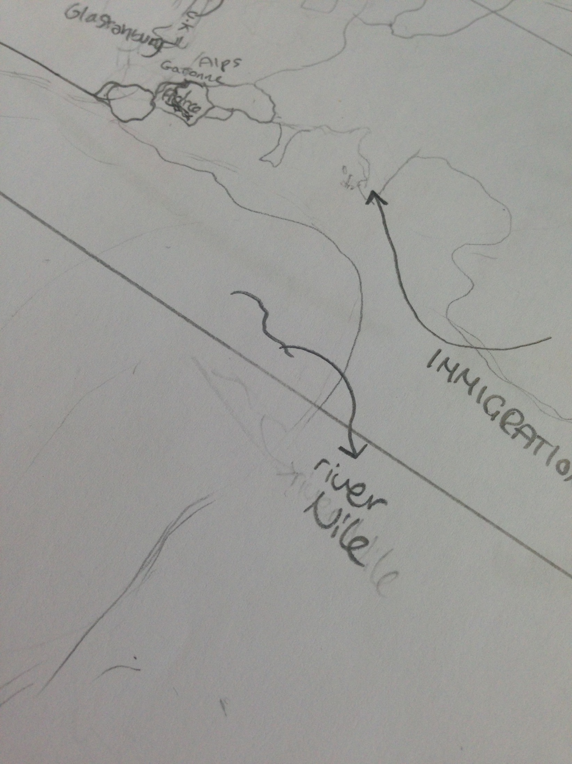

Slide 9
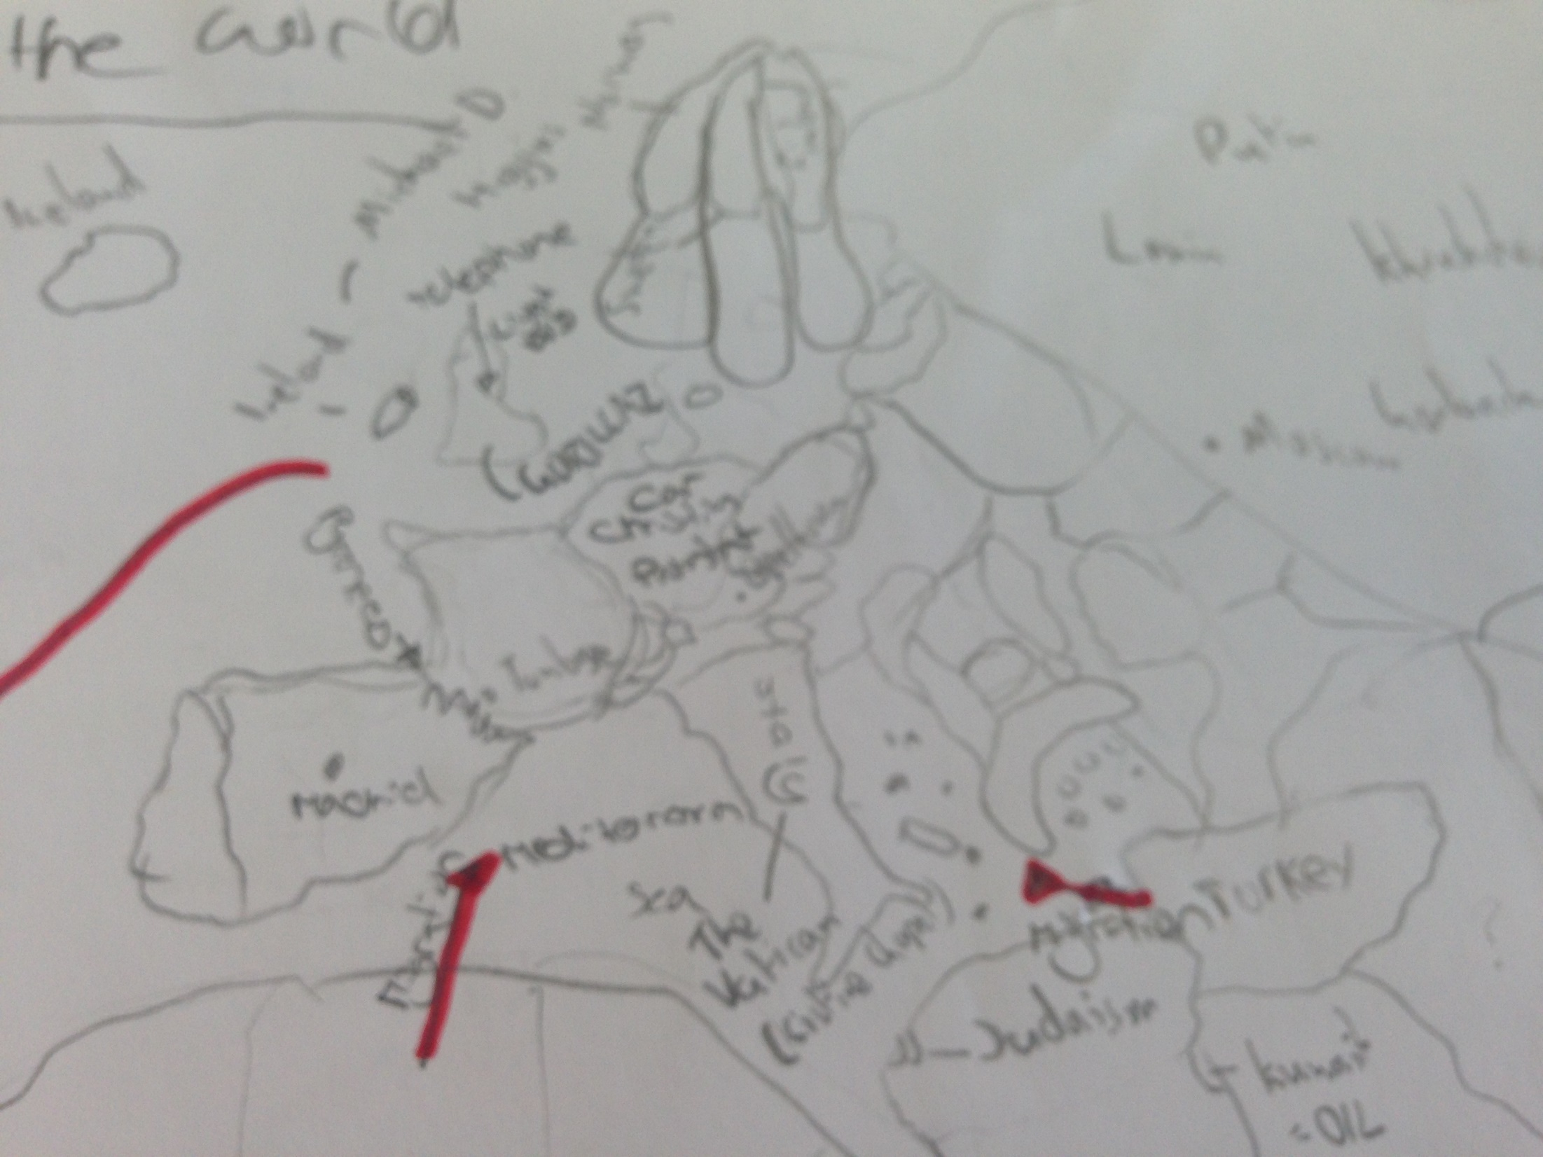

Slide 10
