Slide 1
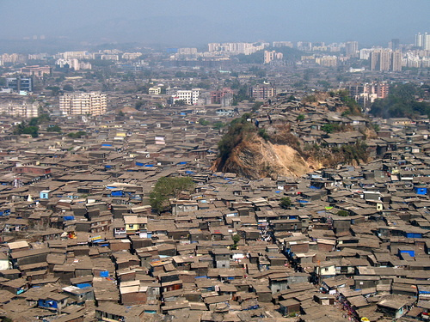
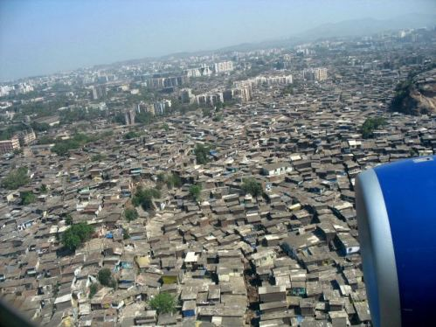
Management of Urbanization The Dharavi Solution
Objective: To find out what can be done to make life better in fast-growing cities.

Slide 2
Some Key Terms
Infrastructure – The basic amenities that people need in a city, such as roads, sewerage, electricity and water supplies.
Squatters – People who occupy the land illegally and may build houses there.
Upgrading – Making conditions better.

Slide 3
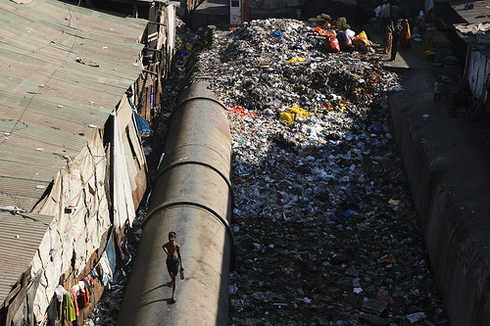

Slide 4
Factfile
The Dharavi District
Has a population of nearly 1 million people
Cover an area of about 525-550 acres (growing)
There are about 15,000 small workshops and factories
People recycle cardboard and plastic to make a living
This makes about €400 million per year.

Slide 5
Hollywood Dharavi

Slide 6
Mumbai's Slums—the Real Scene Behind "Slumdog Millionaire"

Slide 7
Activities
http://www.geographyalltheway.com/in/gcse-settlement/squatter_dharavi.htm
Complete the worksheet on Dharavi
Complete the exam practice worksheet.

