Slide 1
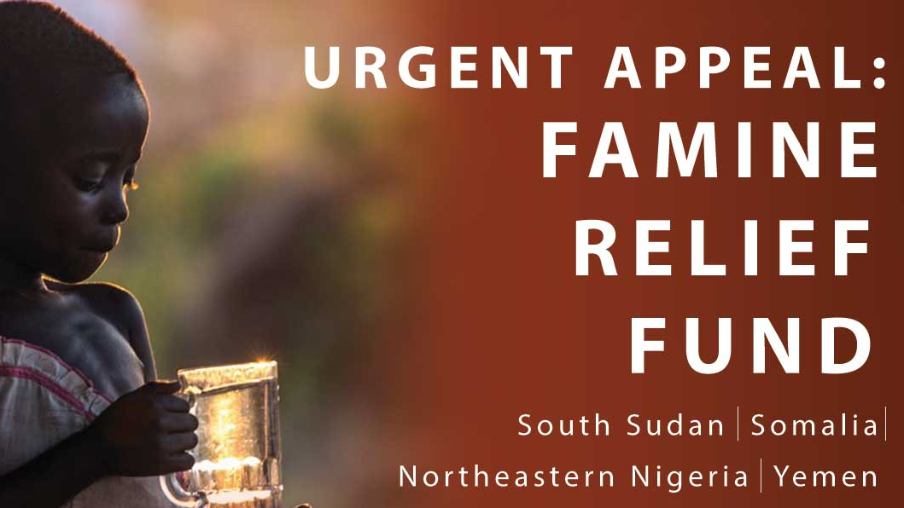
Grade 8 Malnutrition & Under-nourishment
Part 1 - Not enough of the right types of food

Slide 3
