Slide 1
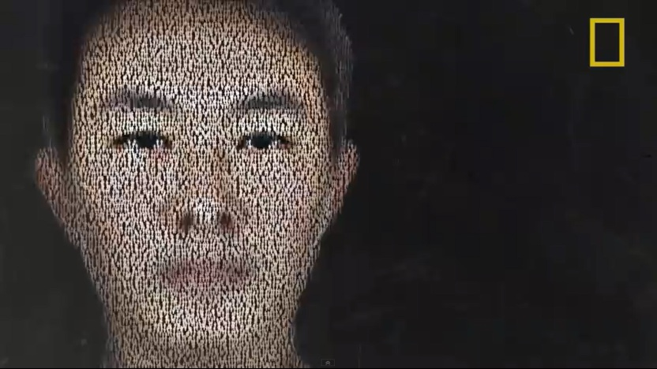
GCSE Geography – Population Who is this person??

